Slide 1
Ingredients of Institutional Fund Raising
An experience sharing
Presentation by
Govinda Neupane
Country Director
IM Swedish Development Partner

Slide 2
Outline of presentation
TOP SIX MANTRAS OF INSTITUTIONAL FUND RAISING
Prerequisites for writing or designing high quality/winning proposal
Priorities and approaches of Institutional Donors in Nepal
Potential donors for Nepali I/NGOs
Opportunities and Challenges for FR in Nepal

Slide 3
Six Mantras for institutional fund raising
Strong internal control system (program and financial management)- organizational, technical and financial management capacity- transparency, accountability, Integrity
Reputation of organization-Visible impacts/results of your work (strong relevant past experience)
Visibility (documentation and branding) of the organization’s work
Well established RELEVANT partners’ portfolio/consortium
High quality proposal/concept note
Public Relation/Networking/Engagement with potential donors

Slide 4
Pre requisites for high quality proposal/grant writing
Institutional FR is not a short-cut road and [Note: average success rate in FR is 10-20% for capable organization and 5-10% young organization]
Well thought and analytical Strategic Plan and Thematic Programmatic Strategies in place
Fund raising strategy and separate dedicated staff in place
Regular updated research and intelligence gathering of donor’s priorities, plans and focuses
Quality review of the thematic priorities and approaches of donors or call guidelines and evaluation criteria, formats
Ensure the match of own priorities and approaches with donors
Research and establish Relevant Consortium or partners portfolio with different sets of added values- 1+1=3 or more- consider active partnership with government and private sectors

Slide 5
Pre-requisite contd…
Quality and authentic and participatory context analysis, policy analysis and stakeholders and target groups analysis
Innovative concept/ideas
Find out the Niche or added values of your organization or consortium partners
Apply Growth mind sets building on your past experience/results
High quality proposal/concepts-concise/direct writing, clear, analytical write up, well-articulated, good presentation skills
Relevance with priorities of donors, government and own org and sustainability section (majority proposals fail in this section)
[Note: proposal reviewer/consultant has hardly ? hours for one concept note of four pages]

Slide 6
Pre-requisite contd..
High quality LFA- clear, logically linked as per your project’s theory of change
High Quality Budget- based on your organization rule, practice and market price, cost effective (majority fails in this)
Quality implementation- show-case visible and tangible impacts!
Involve donors in implementation in different ways! Strategic philanthropy or partnership

Slide 7
Priorities and approaches of Institutional Donors
European Union:
Multiannual Indicative Programme (MIP) 2014-2020 for Nepal, mentions
Budget: indicative budget of €360 million for MIP 2014-20
Sector 1 Sustainable Rural Development (EUR 146 million – 40.5 %)
Sector 2 Education (EUR 136.4 million – 38 %)
Sector 3 Strengthening democracy and decentralization (EUR 74 million – 20.5 %)
Channelize via Government on-budget support- approx. 100%
National and International CSOs support/complementary role- approx. 10% i.e. 10-12 mill EUROs annually- at least 20-25 projects including internal calls

Slide 8
Priorities and approaches of Institutional Donors
European Union:
reconstruction is an important focus (After 2015 earthquakes)
Human rights and democracy (EIDHR)
Humanitarian Aid (ECHO) - Relief and DRR
Regional programs like Switch Asia, Aid for Trade
Global programs/funding instruments:
NSA-LA for poverty reduction and sustainable development strategies
Civil Society Organizations and Local Authorities’ (CSO&LA)

Slide 9
Priorities and approaches of Institutional Donors
European Union:
Global SECTORs/priorities
Human rights and democratic governance
Food and agriculture
Economic growth
Human development
Infrastructure
Environment
Energy
Migration and asylum

Slide 10
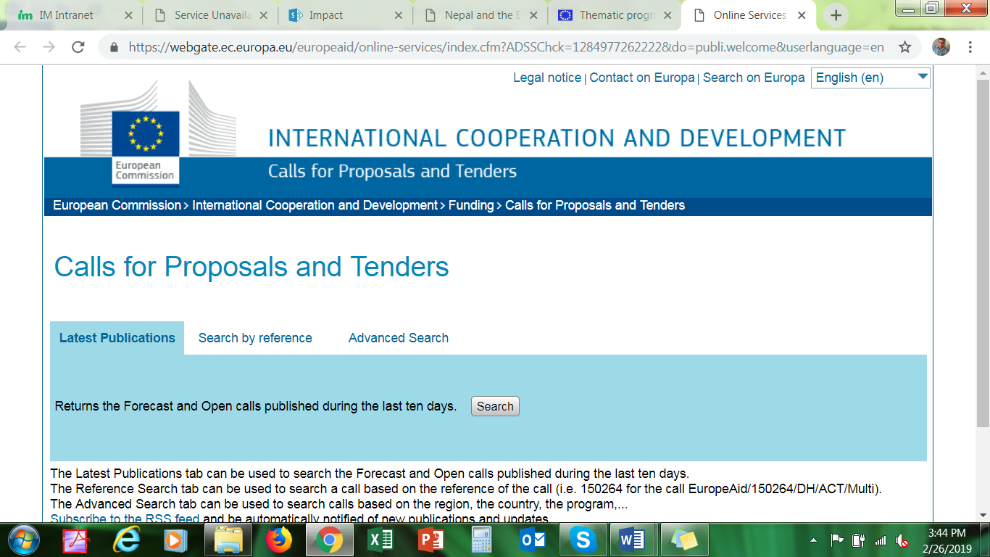
Priorities and approaches of Institutional Donors
EU grants searching process:
https://webgate.ec.europa.eu/europeaid/online-services/index.cfm?ADSSChck=1284977262222&do=publi.welcome&userlanguage=en

Slide 11
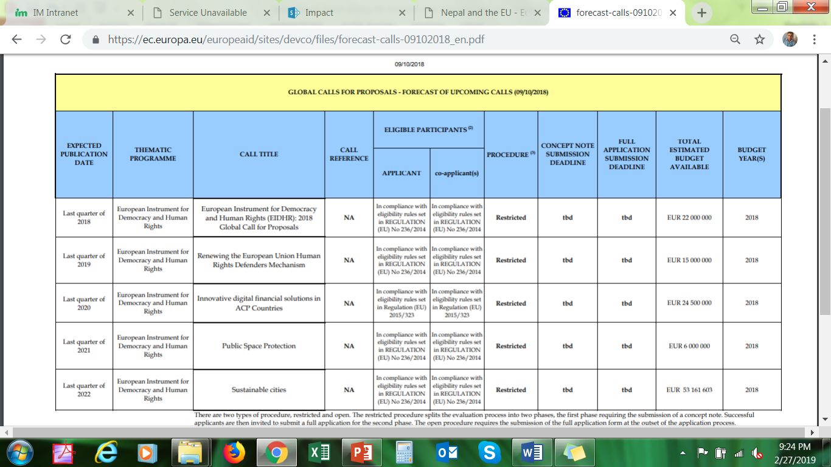
Priorities and approaches of Institutional Donors
European Union:
Search for forecasted global and country calls with timeline (list of projected calls)- very good tool for advance preparation
https://ec.europa.eu/europeaid/search/site/Calls%20forecast_en

Slide 12
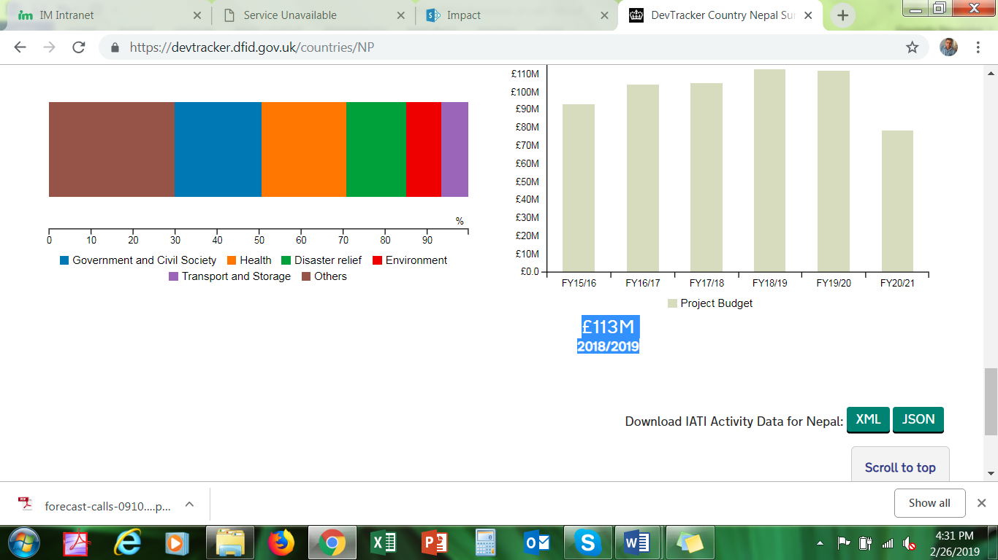
Priorities and approaches of Institutional Donors
Dfid/Ukaid :
Economic empowerment/livelihood,
Governance,
Disaster response,
Climate change,
Health
Education
Embassy’s small projects
funds

Slide 13
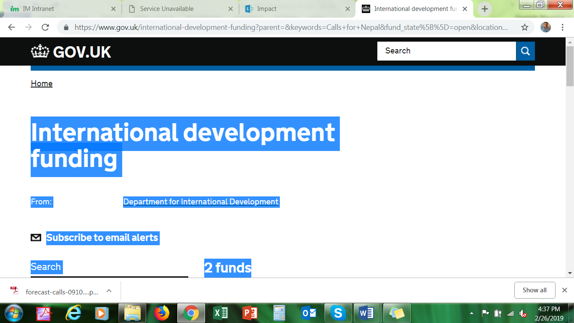
Priorities and approaches of Institutional Donors
Searching calls:
https://www.gov.uk/international-development-funding?parent=&keywords=Calls+for+Nepal&fund_state%5B%5D=open&location%5B%5D=nepal&development_sector%5B%5D=agriculture

Slide 14
Priorities and approaches of Institutional Donors
USAID:
Agriculture and food security
Democracy, Human Rights and Governance
Economic Growth and Trade
Education
Environment and Global Climate change
Global Health
Earthquake reconstruction and disaster resilience

Slide 15
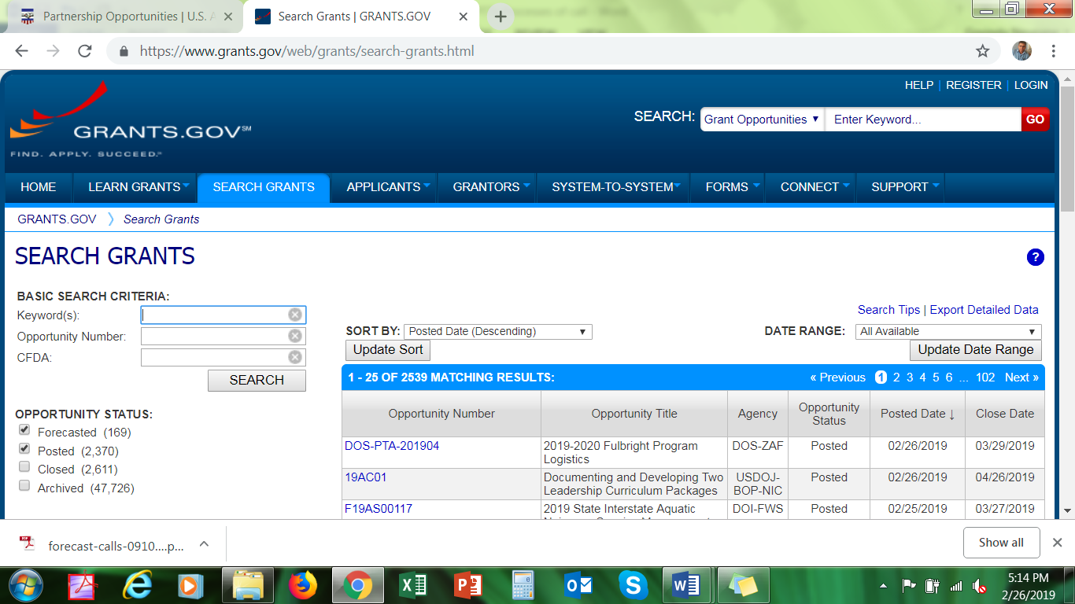
Priorities and approaches of Institutional Donors
Searching USAID grants: grants.gov,

Slide 16
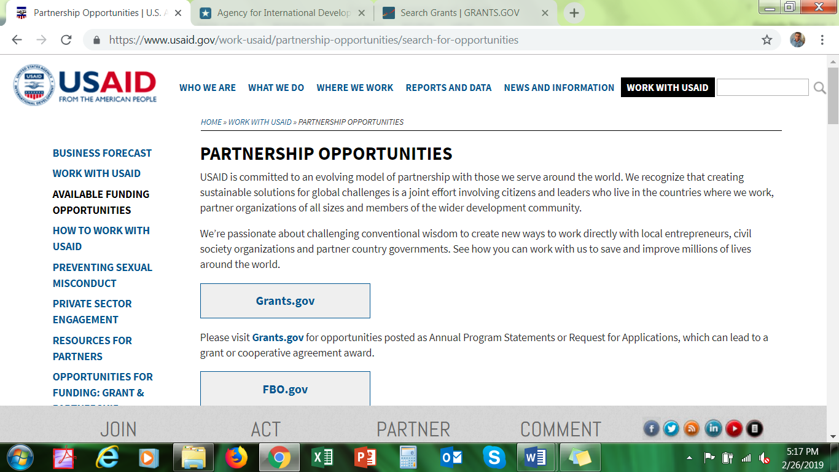
Thank you

Slide 17
Priorities and approaches of Institutional Donors
Donors approaches:
Consortium approach- ecosystem and synergetic partnership approach
Private sector approach
Mobilizing international development contractor- need PR with them
Mobilizing resources through government agencies and UN agencies
Solicited approach for funding
Unsolicited approach for funding- mainly for thematically pioneer organization or small projects by embassies or solidarity funds
Co-financing, and pre-financing

Slide 18
Potential donors for Nepali I/NGOs
Top 5 donors as per AMP/finance ministry fund disbursement reports of 2017/18:
WB group- USD 533 million
ADB- USD 291 millions
UK- USD 123 millions
USAID- USD 117 millions
EU- USD 116 million
Off budget top donors (USD): USAID-109 mill, UK- 49 mill, EU-45 mill (I/NGO be part of it)

Slide 19
Potential donors…..
Human rights, Democracy and CSOs sector
EU
Finida, Danida, Sida, NORAD, UK Aid/DFID, Ausaid, USAID
Foundations- Amplify Change-UK, Open Society Foundation (OSF)
Economic empowerment/livelihood/agriculture sectors:
EU, DFID, USAID, Major corporate foundation
Water and Sanitation:
AUSAID, DFID, International Foundations, Finida
Health and Education:
All major donors of Nepal and global corporate foundations, CSR

Slide 20
Opportunities for Institutional fund raising
Presence of INGOs and experienced technical I/NGOs- good for strategic alliance/consortium
Potentiality for partnership or promoting different sets of complementing roles from many I/NGOs
Shifting giving trend in Asia- Increasing Business sectors in Asia
Corporate Social Responsibilities (CSR) in Asia and Nepal business and companies- e.g. Bank has CSR of 1.5 %

Slide 21
Opportunities for Institutional fund raising
Private Corporate Foundation Funding in Asia and Nepal
New donors from Asia and middle east e.g. KOICA, China Aid, Ausaid, bilateral donors from Arab country governments, Israel
Crowd funding/individual funding/giving trend- increasing middle classes in Nepal too
Government funding to NGOs

Slide 22
Challenges for Institutional FR
Highly competitive
Access of institutional donors- e.g. language barrier in their website for non-English speaking donors e.g. Finida, NORAD, Danida, NORAD- only keeps in website
Difficult processes for finalizing budget and LFA in EU formats
Shrinking space of CSOs/NGOs in Nepal due to government policies

Slide 23
Challenges for Institutional FR
Global shrinking of funding- especially from EU countries, US, Canada, UK for long term development work
Donors or host government priorities- could be difficult for I/NGOs
Fund cut off- more focus on other countries, except disaster in the Asia
No enabling environment
CSOS/NGOs/INGOs capacity on fund raising skills/systems

Slide 24
Lesson learnt and Way forward ….
Institutional FR takes time- could be 1-5 years
Adopt the six Mantras
Develop capacity building at all levels
Be patience, learn from failure, continue hard work
Be open, transparent about your work
Promote networking as much as possible
Work with ecosystem of partners/stakeholders

Slide 25
Thank you for your attentive listening!
Questions and comments?

